Slide 1
Final Report - Facial Expressions classification
Moshe Ofer
Talor Langnas
Avichai Mizrachi
March 2024

Slide 2
AGENDA
Introduction
Project Description
Data Description
Model Architecture
Training process
Previous Attempts
Results & comparison
Future Work

Slide 3
Introduction
Emotion recognition tech is crucial for behavior understanding and user experience (UX).
This report explores CNN-based facial expression recognition.
Achieves 0.61 test accuracy, with insights for improvement.

Slide 4

Project description

Slide 5
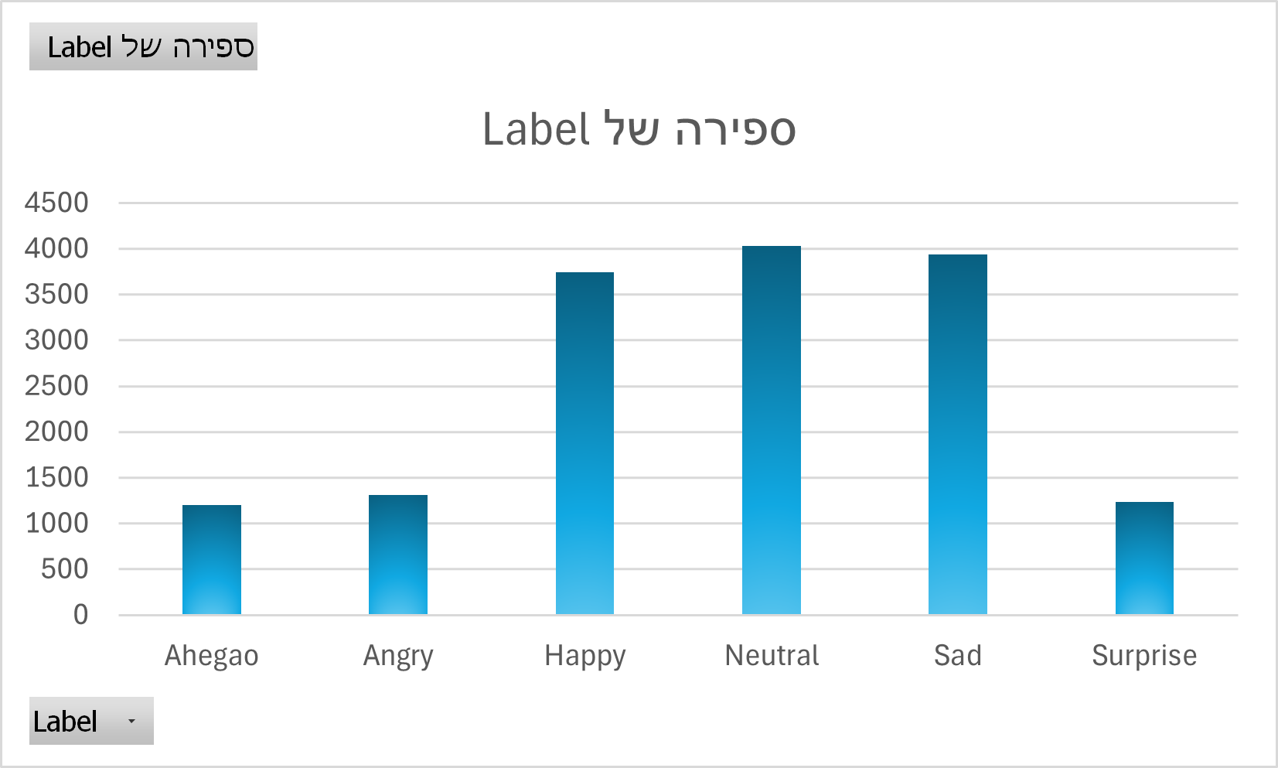
Data DESCRIPTION
15,454 images of cropped faces representing six distinct facial expressions:
Each image is in RGB format and is tagged by a corresponding label indicating the true expression
Happy
Angry
Sad
Neutral
Surprise
Ahegao

Slide 6
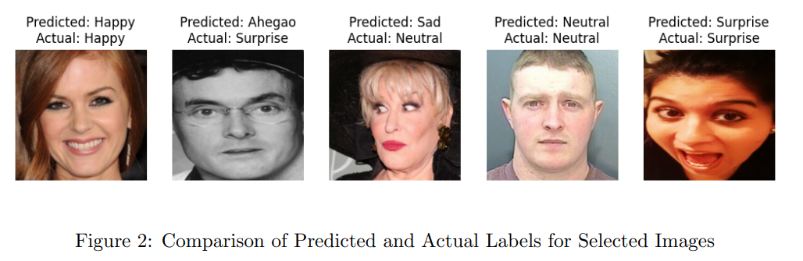
Data PROCESSING
Resized all images to a size of 222 × 222 pixels
Data Augmentation: horizontal flipping, random rotation (up to 10 degrees), and random zooming (up to 10 presents), enhancing the model’s ability to generalize to unseen data.

Slide 7
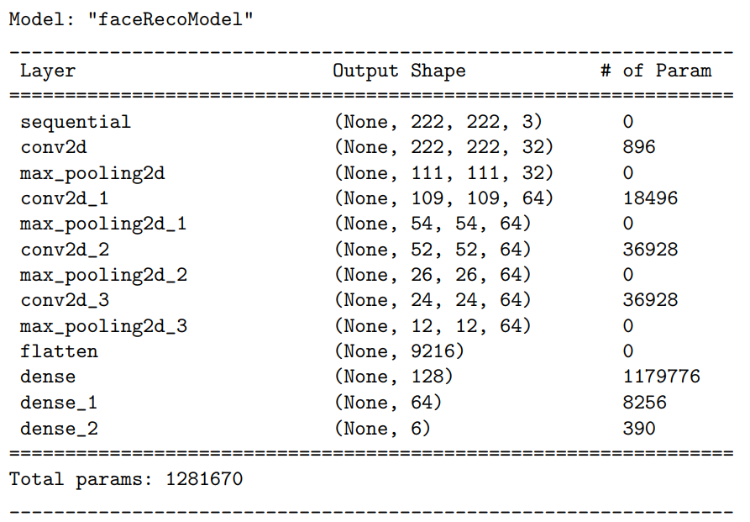
Model Architecture

Slide 8
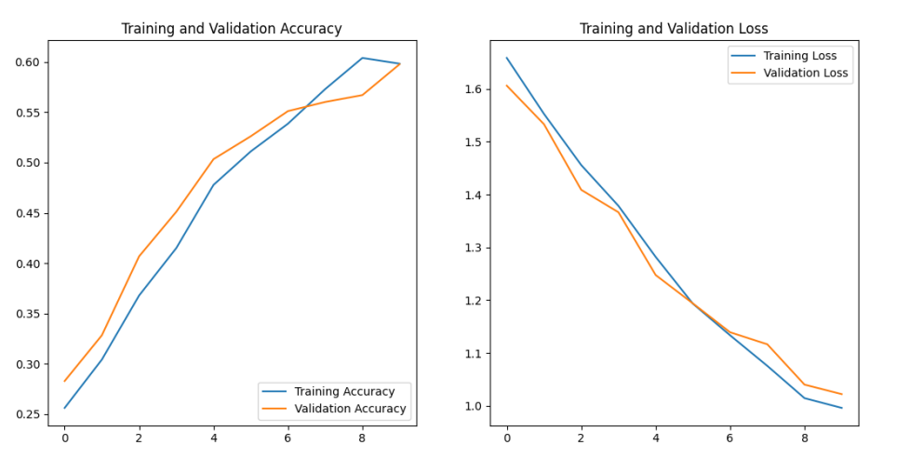
Training process
Data split: 70% of the data for training, 15% for testing, and 15% for validation
Run 10 epochs
Batch size of 32 (default)
Optimizing the categorical cross-entropy loss function, using the Adam optimizer

Slide 9
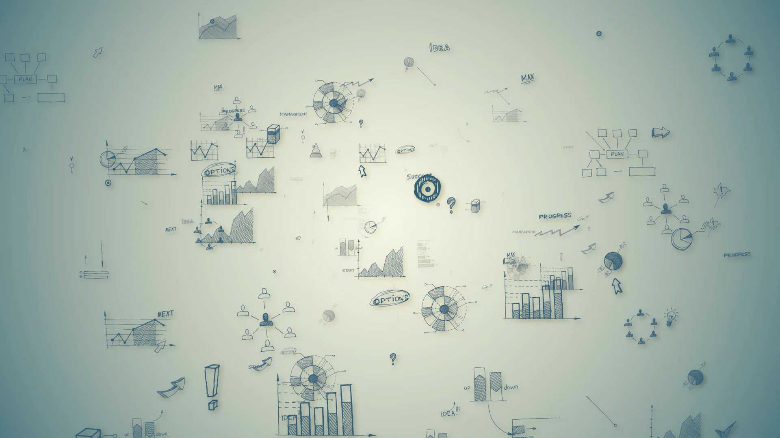
Previous Attempts
Initially, we used a simpler model for facial recognition, but it didn't perform well.
To improve, we increased model complexity and expanded the number of parameters.
Overfitting was an issue, so we limited epochs and increased the training data (different split).
These adjustments greatly improved accuracy and generalization.

Slide 10
Log. Regression
MLP
Layer | Size | Activation
Input | (222, 222, 3) | -
Dense (Output) | 6 | Softmax
Layer | Size | Activation
Input | (222, 222, 3) | -
Dense (Hidden Layer 1) | 500 | ReLU
Dense (Hidden Layer 2) | 250 | ReLU
Dense (Hidden Layer 3) | 64 | ReLU
Dense (Output) | 6 | Softmax

Slide 11
Results & comparison
Model | Accuracy
Log. Regression | 36%
MLP | 52%
CNN | 61%

Slide 12
Future Work
Enhanced Data Processing: Exploring advanced techniques like elastic deformations, color jittering, and style transfer can diversify and expand the dataset.
Architecture Optimization: Experimenting with various CNN architectures and techniques can improve accuracy and efficiency while capturing subtle facial features.

Slide 13
THANK YOU
Moshe Ofer
Talor Langnas
Avichai Mizrachi

